Slide 1

Towards Adapter-based Multi-domain Adaptation and Evaluating Factuality in Language Models
Selim Yagci
Research Group Social Computing Department of Computer Science
School of Computation, Information and Technology
Technische Universität München (TUM)
06.11.2024, Thesis Presentation

Slide 2



Motivation
General-Purpose LMs
Efficiency
Catastrophic Forgetting
Domain Specific Needs
Hallucination

Slide 3
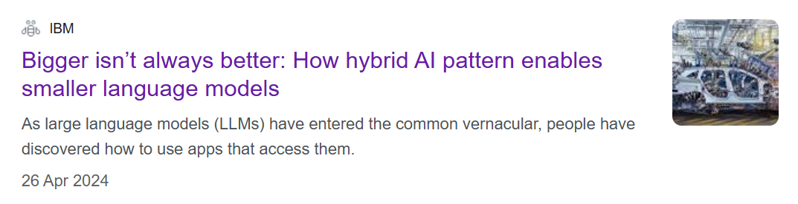
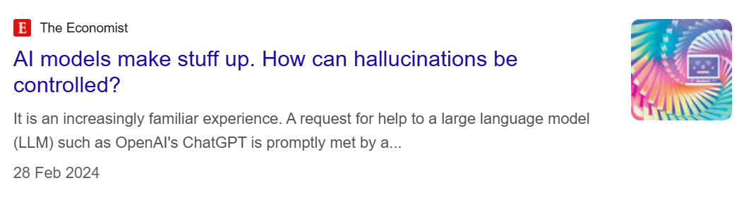
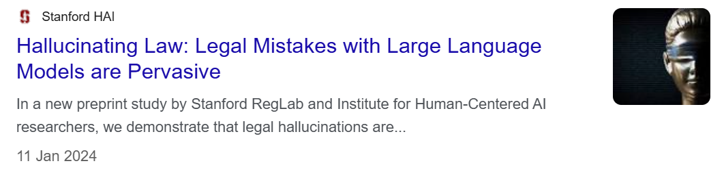
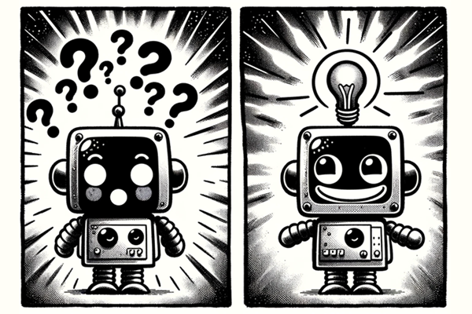
Motivation

Slide 4
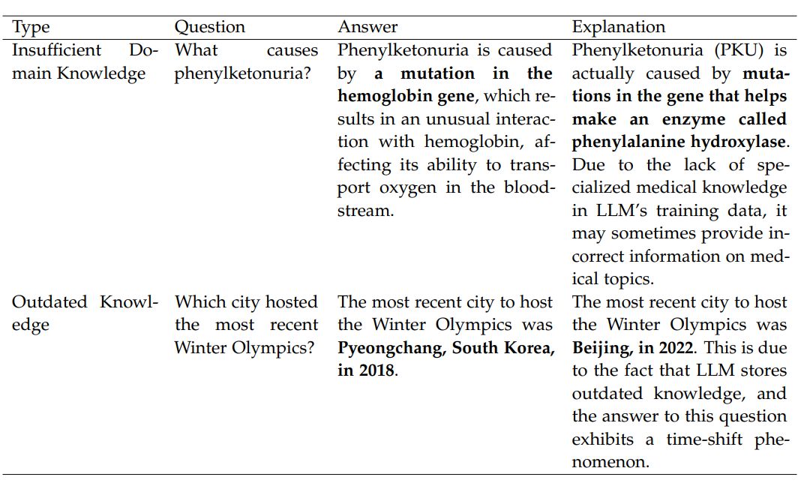
Motivation
Hallucination reasons
Insufficient Domain Knowledge
… mutations in the gene that helps make an enzyme called phenylalanine hydroxylase…
Outdated Knowledge
…Beijing, in 2022…

Slide 5
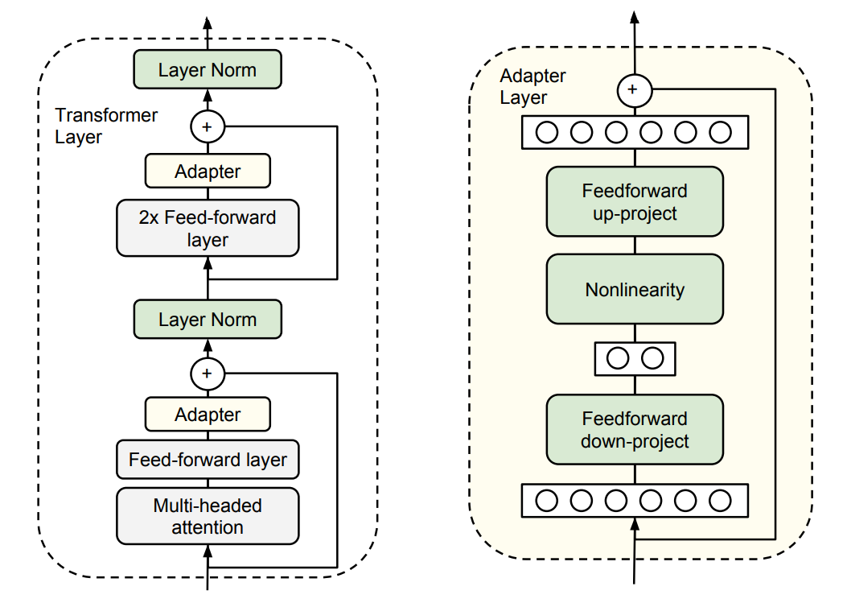
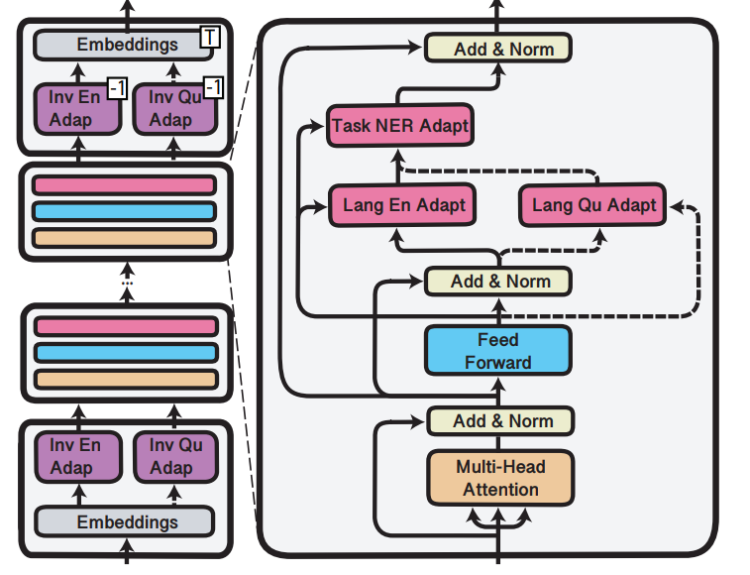
Background: Adapters
Houlsby Adapter
Pfeiffer Adapter

Slide 6
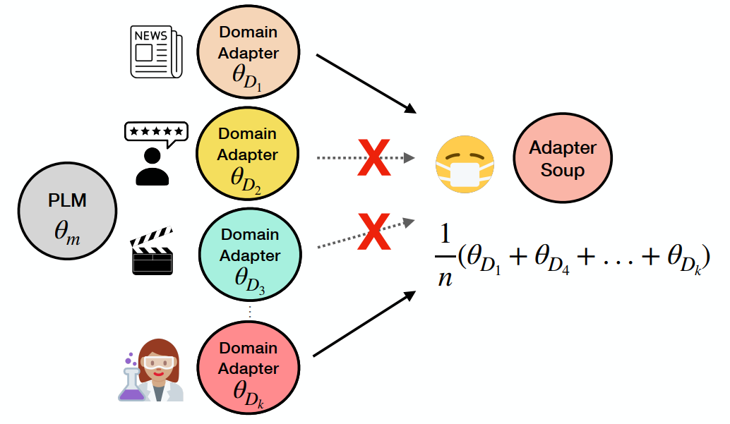
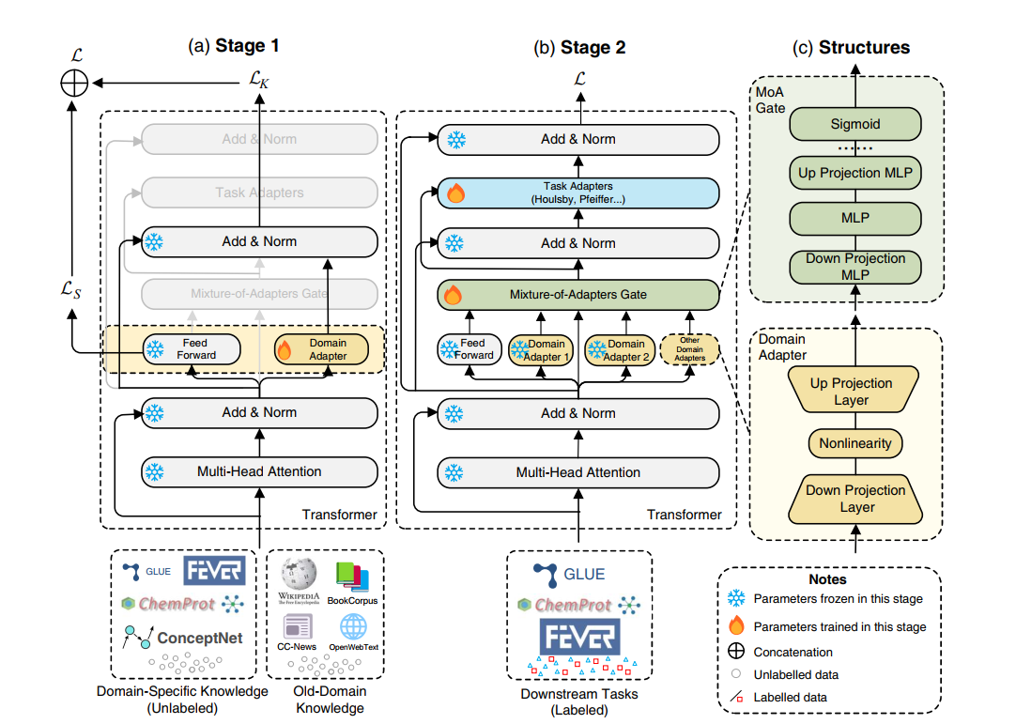
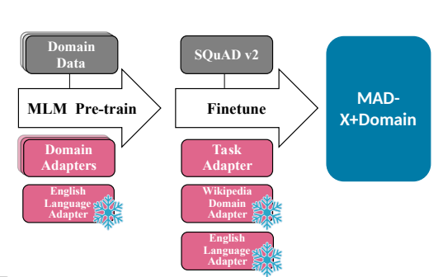
Background: Adapters
Multiple Adapter Frameworks
AdapterSoup
MixDA
M2QA

Slide 7

Background: Evaluating Factuality
ROUGE
BERTScore
Lexical Matching
Semantic Similarity
Atomic Facts
BLEU
LLM-based Evaluation
Self Check
Identifying Conflicts
GPTScore

Slide 8
Research Questions
RQ1
How well domain-specific adapters improve the performance of pretrained language models in generative question-answering tasks for a single domain?
RQ2
Can language models acquire multi-domain knowledge in a multiple-adapter setting where each adapter is trained on distinct domain-specific knowledge?
RQ3
Are current automatic evaluation metrics for factuality comprehensive enough to assess the performance over a multi-domain generative QA setting?

Slide 9
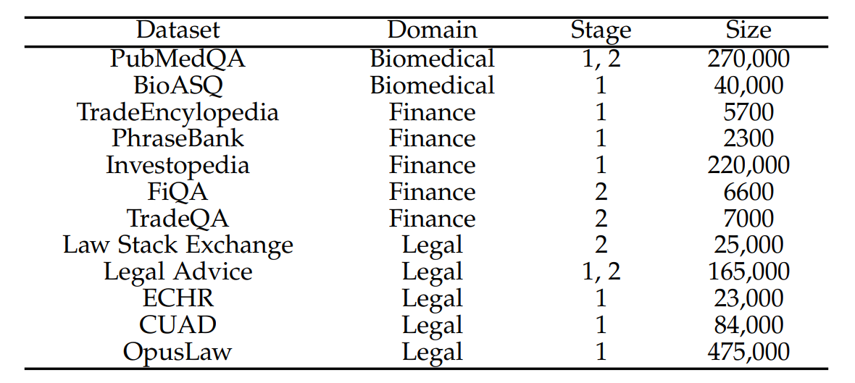



Methodology: Datasets

Slide 10
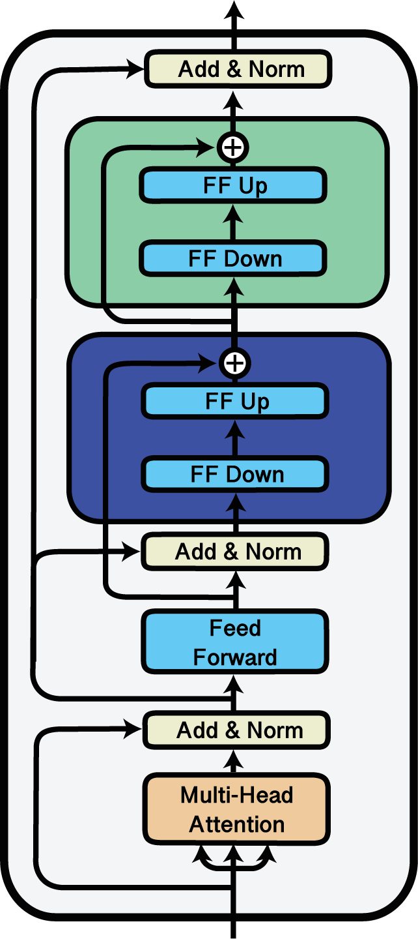



Methodology: Experimental Setup
Stage 1
Stage 2
Task Adapter
Domain Adapter
Domain Adapter

Slide 11


Methodology: Experimental Setup
Query
Add & Norm
Task Adapter T1
…
Adapter Selection
Domain Adapter D1
…
…
Add & Norm
FFN
Query Embedding
Add & Norm
D1 Average Embedding
Multi-head Attention

Slide 12



Methodology: Evaluation
Generated
Query
Context
Zero-shot Factuality Prompt
Relevance
Few-shot Factuality Prompt
Support
Factuality
Zero-shot Multi-Aspect Prompt

Slide 13
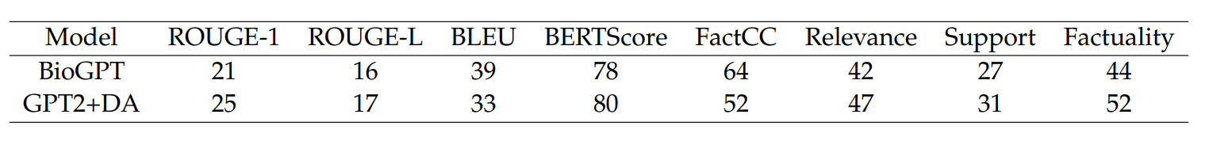
Findings
RQ1
How well domain-specific adapters improve the performance of pretrained language models in generative question-answering tasks for a single domain?
Less than 1% parameter size
Modularity
Domain relevance

Slide 14
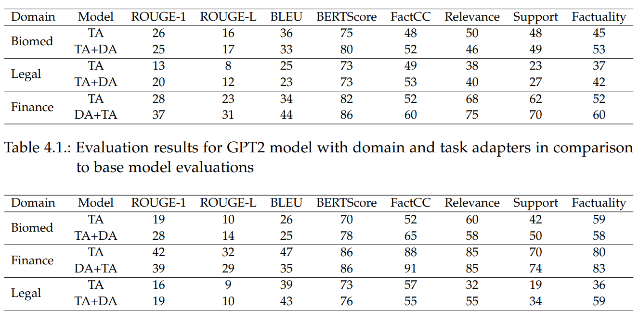
Findings
RQ2
Can language models acquire multi-domain knowledge in a multiple-adapter setting where each adapter is trained on distinct domain-specific knowledge?

Slide 15
Findings
RQ3
Are current automatic evaluation metrics for factuality comprehensive enough to assess the performance over a multi-domain generative QA setting?
Lexical Matching → relevant n-grams during domain adapter fine-tuning
Generated answers contain significantly fewer tokens than the reference texts → BLEU > ROUGE
BERTScore → domain relevance of the generated answers
FactCC → scores overly confident/excessively low

Slide 16
Findings
RQ3
Are current automatic evaluation metrics for factuality comprehensive enough to assess the performance over a multi-domain generative QA setting?
Evaluating outputs that generated for ill-defined questions
When context is not comprehensive enough
Knowledge-intensive type questions and Listing type questions
Inconsistent behavior across domains and sensitive to answer length
Multi-aspect zero-shot prompting

Slide 17




Findings
Effect of the base model
Reflecting the lack of knowledge
Dark matter is a substance in physics. Question: How does dark matter influence the structure of galaxies? Answer: Dark matter creates a protective gravitational field around galaxies, helping them maintain their shape and prevent dispersal.
“I have no idea”

Slide 18






Limitations & Future Research
Several limitations emerged…
Dataset Limitations
Adapters Library
Computational Resources
And there remain multiple avenues for further exploration…
Heterogeneous Knowledge Adapters
Leveraging Domain Adapters in Factuality Evaluation

Slide 19
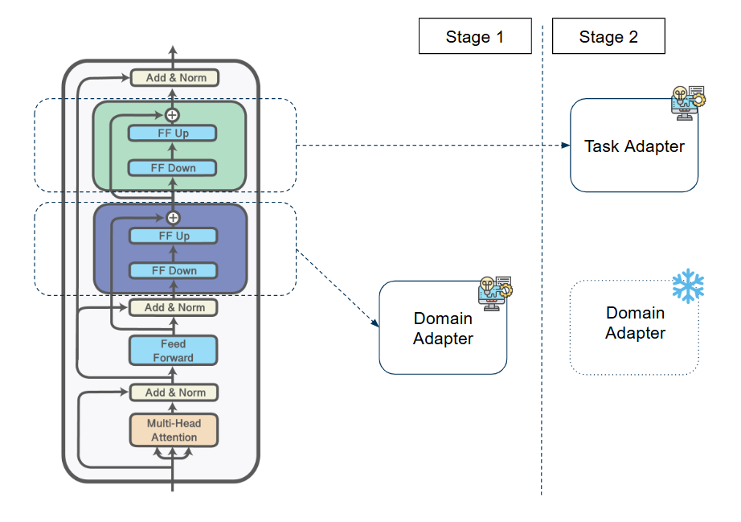
Conclusion
I have no idea
→ Efficiency, Catastrophic Forgetting, Hallucination
→ Multi-domain adaptation on generative QA
→ Factuality evaluation
→ Multiple-adapter framework and adapter selection
→ Dataset limitations
→ Computational resources and documentation
→ Heterogeneous Knowledge Adapters
→ Leveraging Domain Adapters in Factuality Evaluation
→ Comparable performance
→ Parameter-efficient, memory-constrained environments, and straightforward updates
→ Multi-aspect prompt
→ Limitations of Evaluation Metrics
→ Question types

Slide 20
Thank You for Your Attention!

Slide 21
Additional Notes

